Slide 1
Reaction Rates
Reaction rate can be measured in two ways.
By measuring the:
rate of disappearance of reactants
rate of appearance of products

Slide 2
CaCO_{3(s)} + H₂SO_{4(aq)} → CaSO_{4(aq)} + CO_{2(g)} + H₂O_{(l)}
For the reaction above, state three ways the reaction rate could be determined.
By measuring the
1. Rate of disappearance of CaCO_{3(s)}
2. Rate of appearance of CO_{2(g)}
3. Rate of change in pH of solution

Slide 3
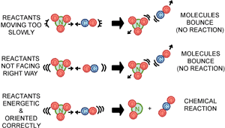
Collision theory states that in order for a reaction to occur, three criteria must be met:
Reactant particles must collide
Reactant particles must collide with a certain minimum energy (activation energy, E­­_{a})
Reactant particles must collide with correct orientation
(John Wiley and Sons Publishers, Inc 2002)

Slide 4
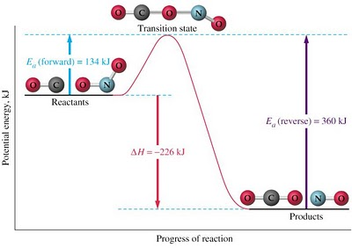
(Enerst 2014)

Slide 5
Key terms:
Enthalpy – the total energy (both chemical potential and kinetic) present in a substance.
∆H – change in enthalpy (H_{products} – H_{reactants})
Activation energy – the minimum energy required to reach the transition state in a reaction
Transition state (activated complex) – highly unstable arrangement in a chemical reaction where bond breaking and forming is occurring. It is a momentary arrangement which has the highest enthalpy for the reaction.

Slide 6
In general, with regards to the activation energy :
As bond strength increases, activation energy increases as more energy is required to break the bonds.
As bond number increases, activation energy increases as more energy is required to break the greater number of bonds.
As the activation energy increases, the rate of reaction decreases.

Slide 7
Factors that Affect Reaction Rate
Temperature
Increasing temperature increases the average kinetic energy of the reactant particles. This increases the proportion of particles that have sufficient E_{k} to meet the activation energy required for a successful collision which increases the reaction rate.
To a much lesser degree, by increasing the kinetic energy of the particles, the particles move faster and in doing so increase the rate (frequency) of collisions that occur which also increases the reaction rate.

Slide 8
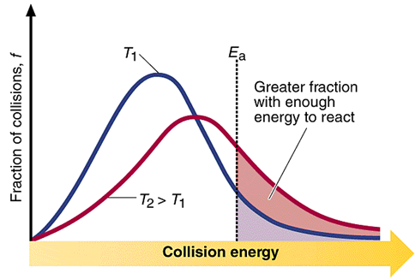
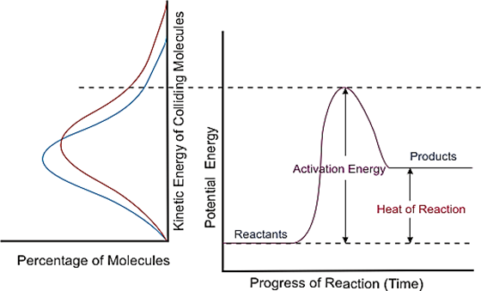
(Luetgens n.d.)
(CDLI 2007)

Slide 9
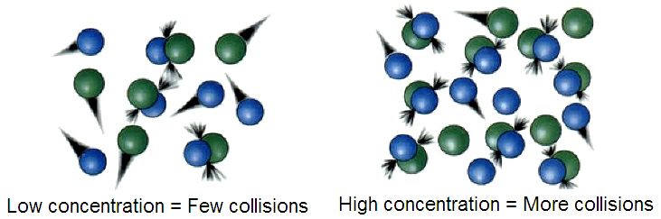
Concentration
When the concentration of one or more of the reactants is increased, it decreases the distance between the particles which increases the rate (frequency) of collisions taking place which increases the reaction rate.
(Wikimedia Foundation, Inc 2015)

Slide 10
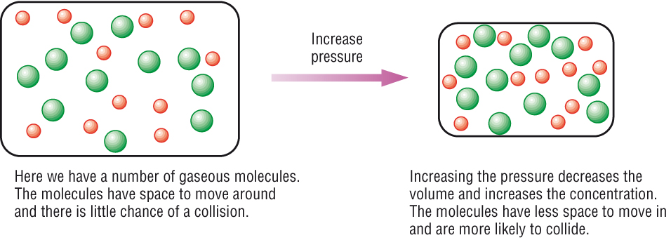
Pressure
Increasing the pressure of a gas by either reducing the volume or adding more of the same gas decreases the distance between the particles which increases the rate (frequency) of collisions taking place which increases the reaction rate.
(Rates of Reaction – Collision Theory n.d.)

Slide 11
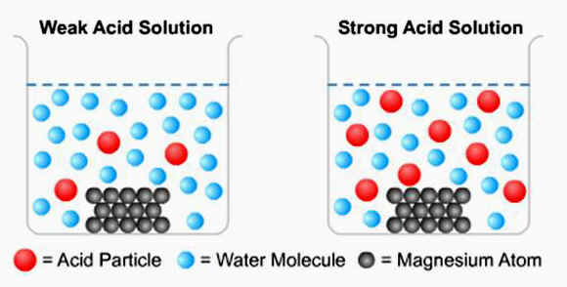
State of Sub-Division
Increasing the surface area of one or more of the reactants (eg through grinding, nebulising (spray), agitation, etc) exposes more reactant particles to each other at one time which increases the rate (frequency) of collisions which then increases the reaction rate.
(Factors Affecting Rate of Reaction n.d.)

Slide 12
Catalysts
Catalysts provide an alternate reaction pathway with a lower activation energy. This means a greater proportion of reactant particles will have sufficient kinetic energy to meet the activation energy required for a successful collision which increases the reaction rate.
Catalysts remain chemically unchanged at the end of the reaction (ie no net consumption of the catalyst occurs).
(Rates of Reaction – Collision Theory n.d.)

Slide 13
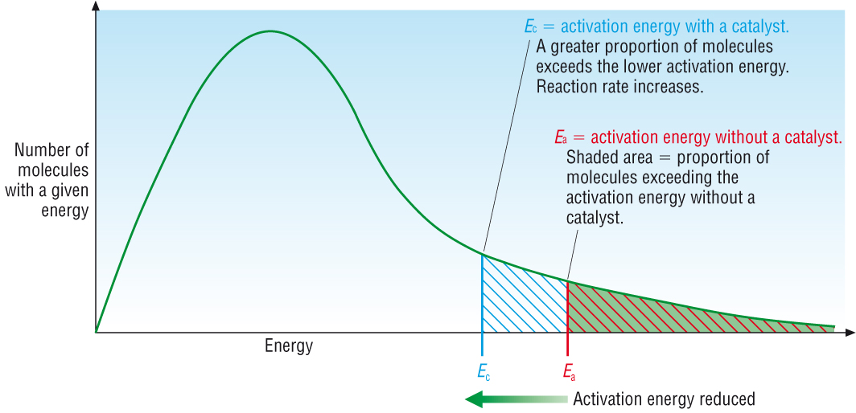

Slide 14
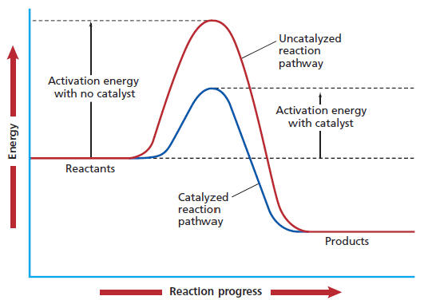
(Collegiate 2009.)

Slide 15
Enzymes: Biological Catalysts
Key terms:
Enzyme – a protein that acts as a specific biological catalyst.
Substrate – the specific reagent molecule(s).
Enzyme specificity – the ability of an enzyme to catalyse a specific reaction.

Slide 16
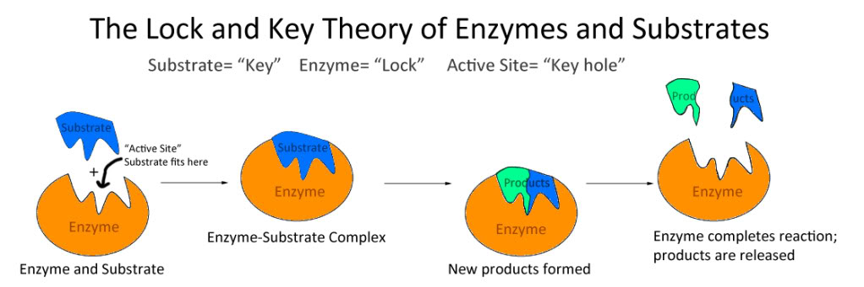
Lock and key model – a model used to illustrate the basic working of an enzyme. The substrate fits onto the active site on the surface of the enzyme where it is held in place by weak intermolecular forces. Whilst docked, the bond rearrangements in the substrate are more easily achieved (increasing the reaction rate). Once reacted, the substrate disengages from the enzyme.
(94067 n.d.)

Slide 17
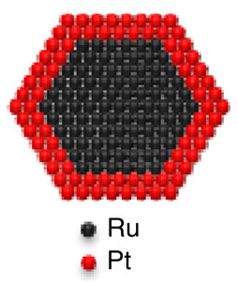
NanoCatalysts
An emerging technology that has a lot of potential applications. Primary advantage is large surface area to volume ratio (maximising contact between catalyst and reactants).
Example: Replacing expensive platinum catalyst in hydrogen fuel cells with a nanocatalyst consisting of a ruthenium core coated with platinum atoms.
(Hseih Y 2013)

Slide 18
Benefits include:
Large surface area to volume ratio
Large surface area to mass ratio
Requires much less of the expensive platinum
Not poisoned by the CO present
Can be manufacture on a large scale using “green” method of production.

Slide 19
Bibliography
94067. "Why is an Enzyme Called Lock and Key Model?" Answers. n.d. http://www.answers.com/Q/Why_is_an_enzyme_called_lock_and_key_model (accessed July 23, 2015).
CDLI. "Factors Affecting Reaction Rates." CDLI. 2007. http://www.cdli.ca/sampleResources/chem3202/unit01_org1_ilo03/b_activity.html (accessed July 24, 2015).
Collegiate, Daniel McIntyre. "Lesson 4 - Factors Affecting Reaction Rate." Mr Lou's Chemistry Website. September 2009. http://www.mts.net/~alou/Chemistry%2012/Unit%203%20-%20Chemical%20Kinetics/Lesson%204%20-%20Factors%20Affecting%20%20Reaction%20Rate.htm (accessed July 23, 2015).
Ernest, Z. "What Do You Understand by The Activation Energy of a Reaction?" Socratic. 2014. http://socratic.org/questions/what-do-you-understand-by-the-activation-energy-of-a-reaction (accessed July 22, 2015).
"Factors Affecting Rate of Reaction." CHanges in Matter. n.d. http://changeinmatter.tripod.com/main/factors_affecting_rate_of_reaction.htm (accessed July 23, 2015).
Hseih Y, Zhang Y, Su D,. "Ordered Bilayer Ruthenium-Platinum Core-Shell Nanoparticles as Carbon Monoxide-Tolerant Fuel Cell Catalysts." Nature Communications. September 18, 2013. http://www.nature.com/ncomms/2013/130918/ncomms3466/abs/ncomms3466.html (accessed July 31, 2015).
John Wiley and Sons Publishers, Inc. "Elementary Kinetics." Concept Reviews. 2002. http://www.wiley.com/college/boyer/0470003790/reviews/kinetics/kinetics_effectors.htm (accessed July 22, 2015).
Luetgens, D. "Temperature and Reaction Rate." Explore, Experiment, Explain: Science An Excellent Adventure. n.d. http://dluetgens.com/temp_and_rxn_rate.html (accessed July 23, 2015).
"Rates of Reaction - Collision Theory." Chemhume.co.uk. n.d. http://www.chemhume.co.uk/ASCHEM/Unit%203/14%20Reaction%20rates/Ratesc.htm (accessed July 23, 2015).
Wikimedia Foundation, Inc. "Collision Theory." Wikipedia. MAy 31, 2015. https://en.wikipedia.org/wiki/Collision_theory (accessed July 26, 2015).

